Slide 1

MIRPUR UNIVERSITY OF SCIENCE AND TECHNOLOGY (MUST), MIRPUR DEPARMENT OF COMPUTER SCIENCE & INFORMATION TECHNOLOGY

Slide 2
Professional Practices BIT-4802 Lecture [10]: Security and Privacy: Computers and Internet
Dr. Samina Khalid
(Assistant Professor)
Date: April 23, 2020

Slide 3

Today’s Agenda
Security
Identification and Access
Software Security
The Internet
Disaster Recovery

Slide 4
Security
System of safeguards designed to protect a computer system and data from deliberate or accidental damage
Natural disasters
Fire
Accidents
Vandalism
Theft
Theft or destruction of data
Industrial spying
Hackers
Notes:
A cyber attack without any obvious rational criminal, political, or ideological motive, usually defacement of a vulnerable website to display the hacker's prowess.

Slide 5
Security Identification and Access
Provide access to authorized individuals only
Uses one of more of the following systems
What you have
What you know
What you do
What you are

Slide 6
Security Identification and Access
What You Have
Key
Badge
Token
Plastic card – magnetized strip
Active badge – signals wearer’s location using infrared signals

Slide 7
Security Identification and Access
What You Know
Password
Identification number
Combination

Slide 8
Security Identification and Access
What You Do
Verify signature – software verifies scanned and online signatures

Slide 9
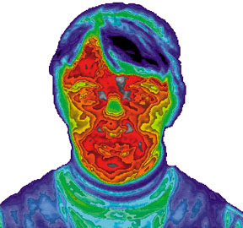
Security Identification and Access
What You Are
Biometrics – science of measuring individual body characteristics
Fingerprints
Voice pattern
Retina of the eye
Entire face

Slide 10
Security Identification and Access
Internal controls
Transaction log
Auditor checks
Who has accessed data during periods when that data is not usually used?
Off-the-shelf software to access the validity and accuracy of the system’s operations and output
software or hardware products that are ready-made and available for sale to the general public.
See off- the-shelf and bespoke software
Notes:
Off the Shelf Software, also called commercial software, is any kind of software solution that has been developed for the mass market. It is a ready-made product that you can purchase. This is in direct contrast to bespoke software, which is where the solution is custom-made for you.
bespoke software
Customised software (also known as bespoke software or tailor-made software) is software that is specially developed for some specific organization or other user

Slide 11
Security Identification and Access
Secured waste
Shredders
Locked trash barrels
Applicant screening
Verify the facts on a resume
Background checks
Built-in software protection
Record unauthorized access attempts
User profile

Slide 12
Security Software Security
Ownership
Company if programmer is employee
Contractual agreement if the programmer is not an employee
Software can be copyrighted
Software copyright is used by Software Developers and proprietary software companies to prevent the unauthorized copying of their software. Free and open source licenses also rely on copyright law to enforce their terms.

Slide 13
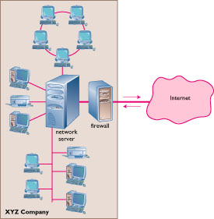
Security The Internet
Firewall
Dedicated computer that governs interaction between internal network and the Internet
Encryption
Data Encryption Standard (DES)

Slide 14
Security Personal Computers
Physical security with locks and cables
Surge protector (A surge protector is an appliance or device designed to protect electrical devices from voltage spikes.)
Uninterruptible power supply (UPS)
Backup files regularly and systematically

Slide 15
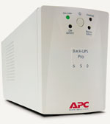
Disaster Recovery
Hardware loss
Can be replaced
Temporarily diminished processing ability.
Software loss
Industry standard – make backups of program files

Slide 16
Disaster Recovery
Data loss
Reassemble records (Repair)
Customer information
Accounting data
Design information
Major costs and time

Slide 17
Disaster Recovery Plan
Restoring computer processing operations and data files if operations are halted or files are damaged by major destruction

Slide 18
Disaster Recovery Plan Approaches
Manual services temporarily
Purchase time from a service bureau
Mutual aid pack
Two or more companies will lend each other computer power
Problem if regional disaster

Slide 19
Disaster Recovery Plan Approaches
Consortium (grouping)
Joint venture
Routinely tested
Used only if disaster
Sites
Hot site – fully equipped and environmentally controlled computer center
Cold site – environmentally suitable empty shell
https://searchdisasterrecovery.techtarget.com/answer/Whats-the-difference-between-a-hot-site-and-cold-site-for-disaster-recovery#:~:text=While%20a%20hot%20site%20is,hardware%2C%20no%20software%2C%20nothing.
Notes:
Cold Site vs Hot Site. A cold site is a work area for disaster recovery that is geographically separated from a firm's primary office location. It may include equipment but information services need to be configured and updated with current data before use.

Slide 20
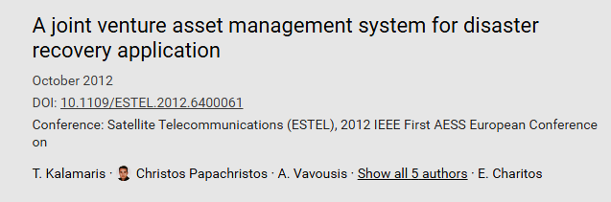
Joint Venture
a framework of resources and procedures for critical infrastructure disaster recovery.
The aim is to create an asset management system consisting of the necessary resources (services, human resources, equipment,) for providers to restore communications in disasters using satellite technology.
The latter provides service to a wide coverage without restrictions to location and access technologies used.
The proposed system will check the compatibility and interactivity of these resources and shall provide a disaster recovery plan when needed, a useful tool for civil protection services of the European countries and the European Union in general.

Slide 21
Disaster Recovery Plan Advance Arrangements
Everything except hardware safely stored in geographically distant locations
Program and data files
Program listings
Program and operating systems documentation
Hardware inventory lists
Output forms
Copy of the disaster plan manual

Slide 22
Disaster Recovery Plan Includes
Priorities for programs
Plans for notifying employees
List of needed equipment and where it is located
Alternative computing facilities
Procedures for handling input and output data

Slide 23
Backup Why Backup?
“If you are not backing up your files regularly, you deserve to lose them.”
Average user experiences loss once a year

Slide 24
Backup What Can Cause Data Loss?
Incorrect software use
Input data incorrectly
Software may harm data
Hard disk malfunctions
Accidentally delete files
Virus infection

Slide 25
Backup
Methods
Full backup
Differential backup
Incremental backup
Media
Diskette
Tape
Zip disk
CD-R / CR-RW
DVD-RAM
Mirrored hard drive
https://www.acronis.com/en-eu/articles/incremental-differential-backups/#:~:text=A%20differential%20backup%20backs%20up,a%20full%20backup%20on%20Sunday.&text=Incremental%20backups%20also%20back%20up,a%20full%20or%20incremental%20backup.

Slide 26
Incremental Backup
Incremental backup Thursday
affect all files modified between Tuesday and Thursday
Full Backup
Friday
1st incremental backup (changed files)
Monday
Differential backup
Tuesday
Differential Backup (cumulative backup)
Full Backup
Friday
Differential backup Monday
cover all files changed between Friday and Monday
Differential backup
Wednesday
cover all files changed since Friday's full backup
https://www.atlantech.net/blog/full-backup-vs.-incremental-backup-vs.-differential-backup-which-is-best

Slide 27
Pests
Invade the computer system and cause something unexpected to occur
May interfere with function of PC

Slide 28
Worms
Rare
Transfers over a network
Plants as a separate file on the target’s computer

Slide 29
Viruses
Illicit instructions that pass themselves on to other programs
Benign
Damaging to computer
Digital vandalism (damage)
Professional Practices
29

Slide 30
Viruses
Vaccine or antivirus
Stops the spread of and eradicates the virus
Install software
Download signature files regularly
Professional Practices
30

Slide 31
Viruses
Retrovirus
Fights the vaccine and may delete the antivirus software
Costs
Billions of dollars a year
Aggravation to individual users
Professional Practices
31

Slide 32
Some Interesting facts about computer viruses
https://visual.ly/community/Infographics/computers/ten-shocking-facts-about-computer-viruses

Slide 33
References
Zlatanov, N., Computer security and mobile security challenges.
spoofing. Oxford Reference. Oxford University Press. 21 January 2016.
Klein, A. and Boodaei, M., Trusteer Ltd, 2015. Detection of phishing attempts. U.S. Patent 9,111,090.
Havens, J.C., 2015. Hacking happiness: Why your personal data counts and how tracking it can change the world. TarcherPerigee.
Montgomery Jr, W.S., Cooley, I.L.H. and Lunday, R.A., Lifecardid Inc, 2005. System and method for using biometric data for providing identification, security, access and access records. U.S. Patent 6,972,660.
Okamoto, E., 1992, June. Proposal for integrated security systems. In Proceedings of the Second International Conference on Systems Integration (pp. 354-358). IEEE.

Slide 34
THANKS

Slide 35
10 marks 15 minutes
What an effective Disaster Recovery Plan Includes?

